Slide 1


Spotify
Music Sentiment Analysis
Neha Thonta - 219009543 Yanhan Chen - 218003651 Varun Gandikota - 216007355 Ganesh Raj Kyatham - 219001760

Slide 2

Upgrade
Team 13
Intro
About Data
Music Sentiment Analysis
Our Artists
Features
Word Cloud
This involves manually analyzing the lyrics of a song to determine the emotional content and tone. The analysis can involve identifying keywords, phrases, and features associated with specific emotions, as well as the overall themes and messages conveyed by the lyrics. This type of analysis can be useful in understanding the emotional impact of a song.
Sentiment Analysis
Conclusion
Play
Follow

Slide 3


Upgrade
Team 13
Intro
About Data
Introduction
Our Artists
Data Sources
Features
Word Cloud
Sentiment Analysis
Conclusion
Spotify API
Genius API
Spotify provides access to its API which allows developers to access and manipulate data related to music, playlists, artists, and more. It provides a variety of endpoints to retrieve information such as audio features, artist details, album details, track details, and more.
The Genius API gives developers access to a database of annotated song lyrics, poetry, and other texts. Developers can use this API to create applications that use the website's content, such as displaying lyrics with annotations and adding lyrics search functionality to music apps. The API provides structured, machine-readable data on annotations and song metadata.

Slide 4
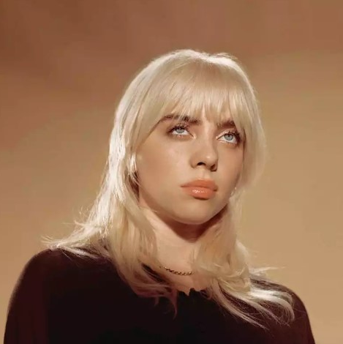


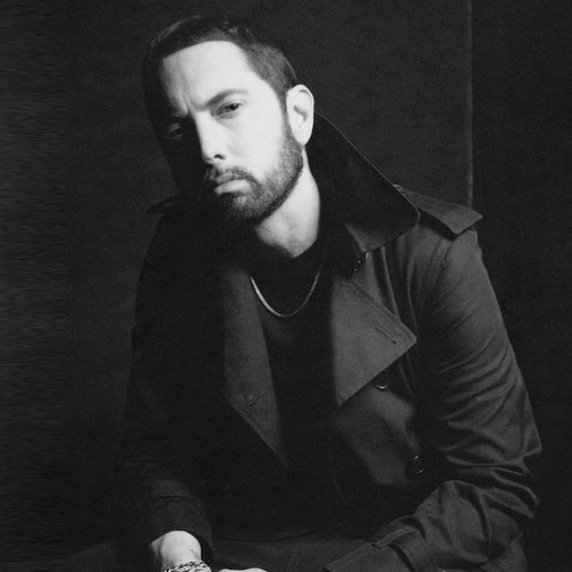
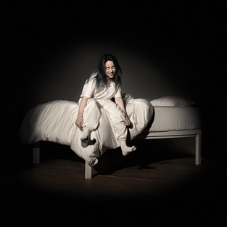
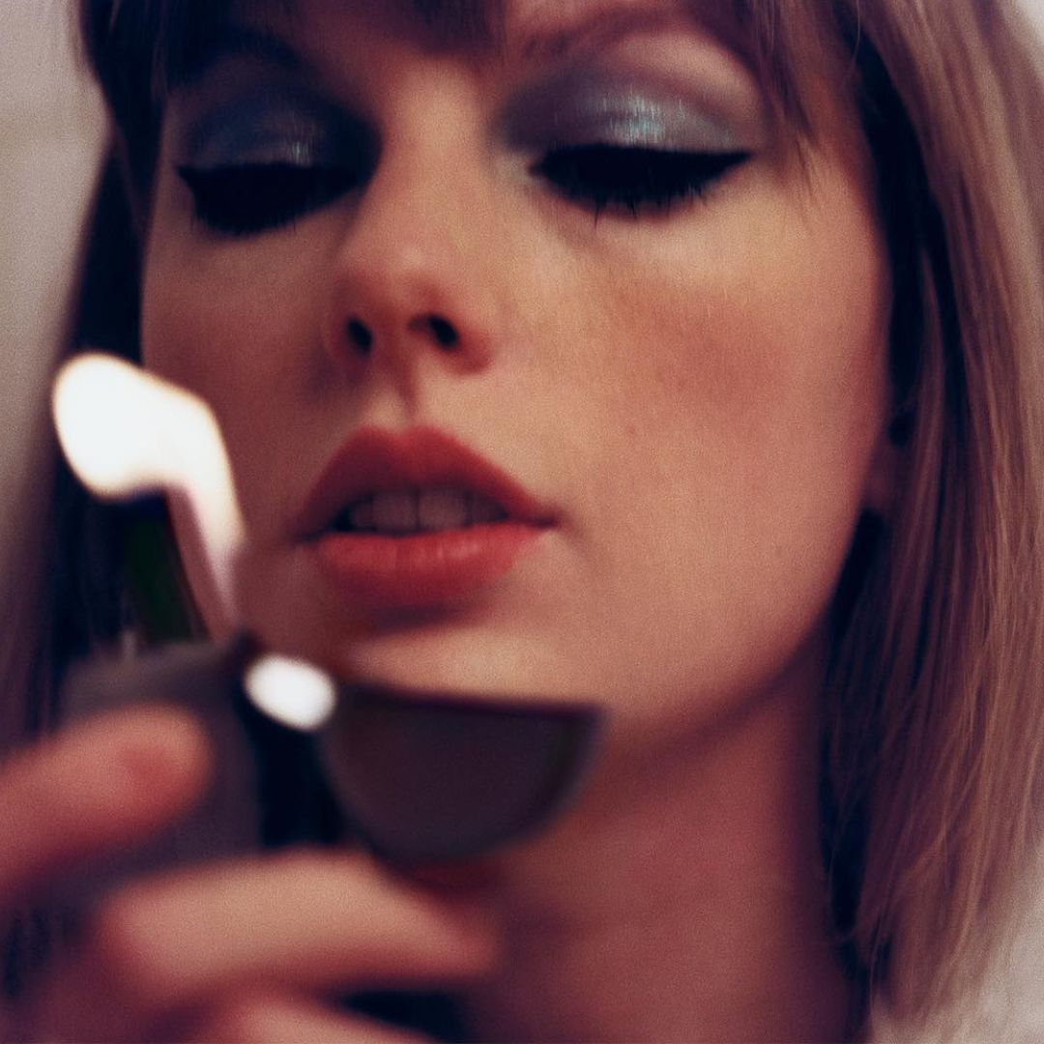
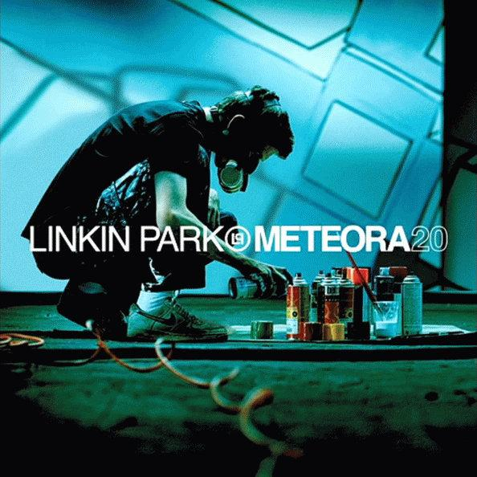

Upgrade
Team 13
Intro
Artists
About Data
Our Artists
Features
Word Cloud
Billie Eilish
Taylor Swift
Linkin Park
Eminem
Sentiment Analysis
Artist
Artist
Artist
Artist
Conclusion
Albums
Tracks - 14 Popularity - 89
Tracks - 13 Popularity - 96
Tracks - 13 Popularity - 80
Tracks - 20 Popularity - 80

Slide 5
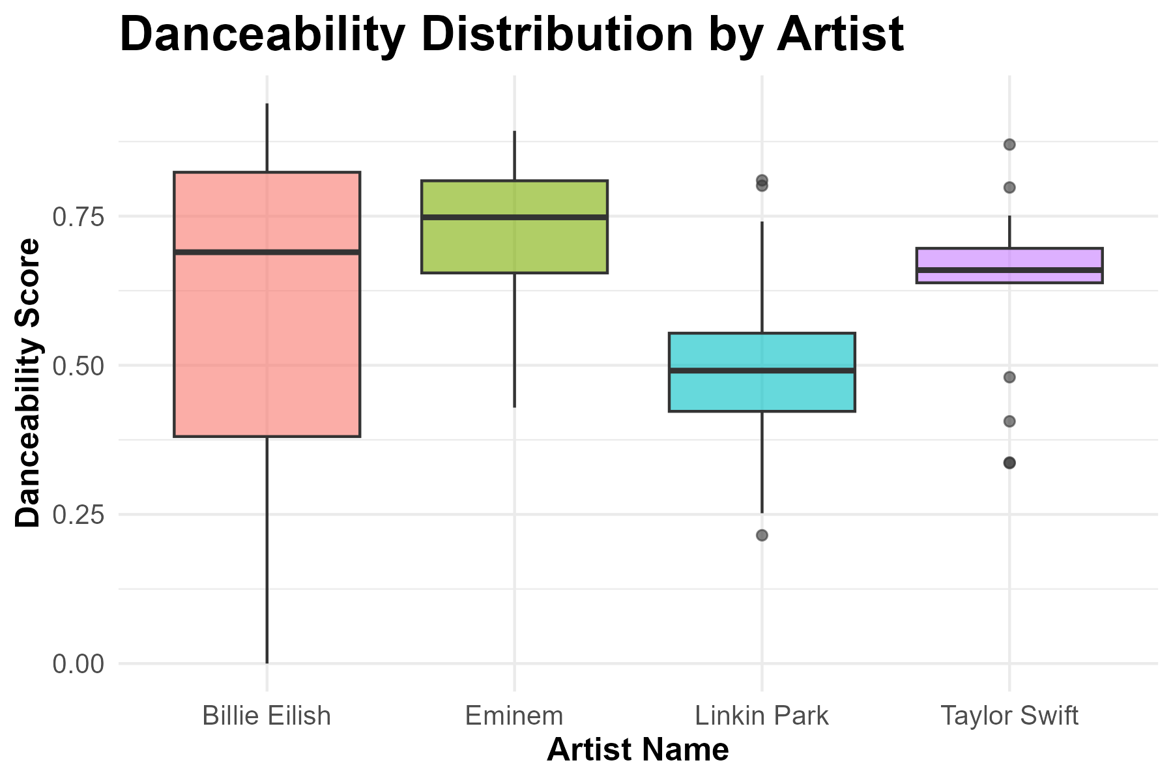
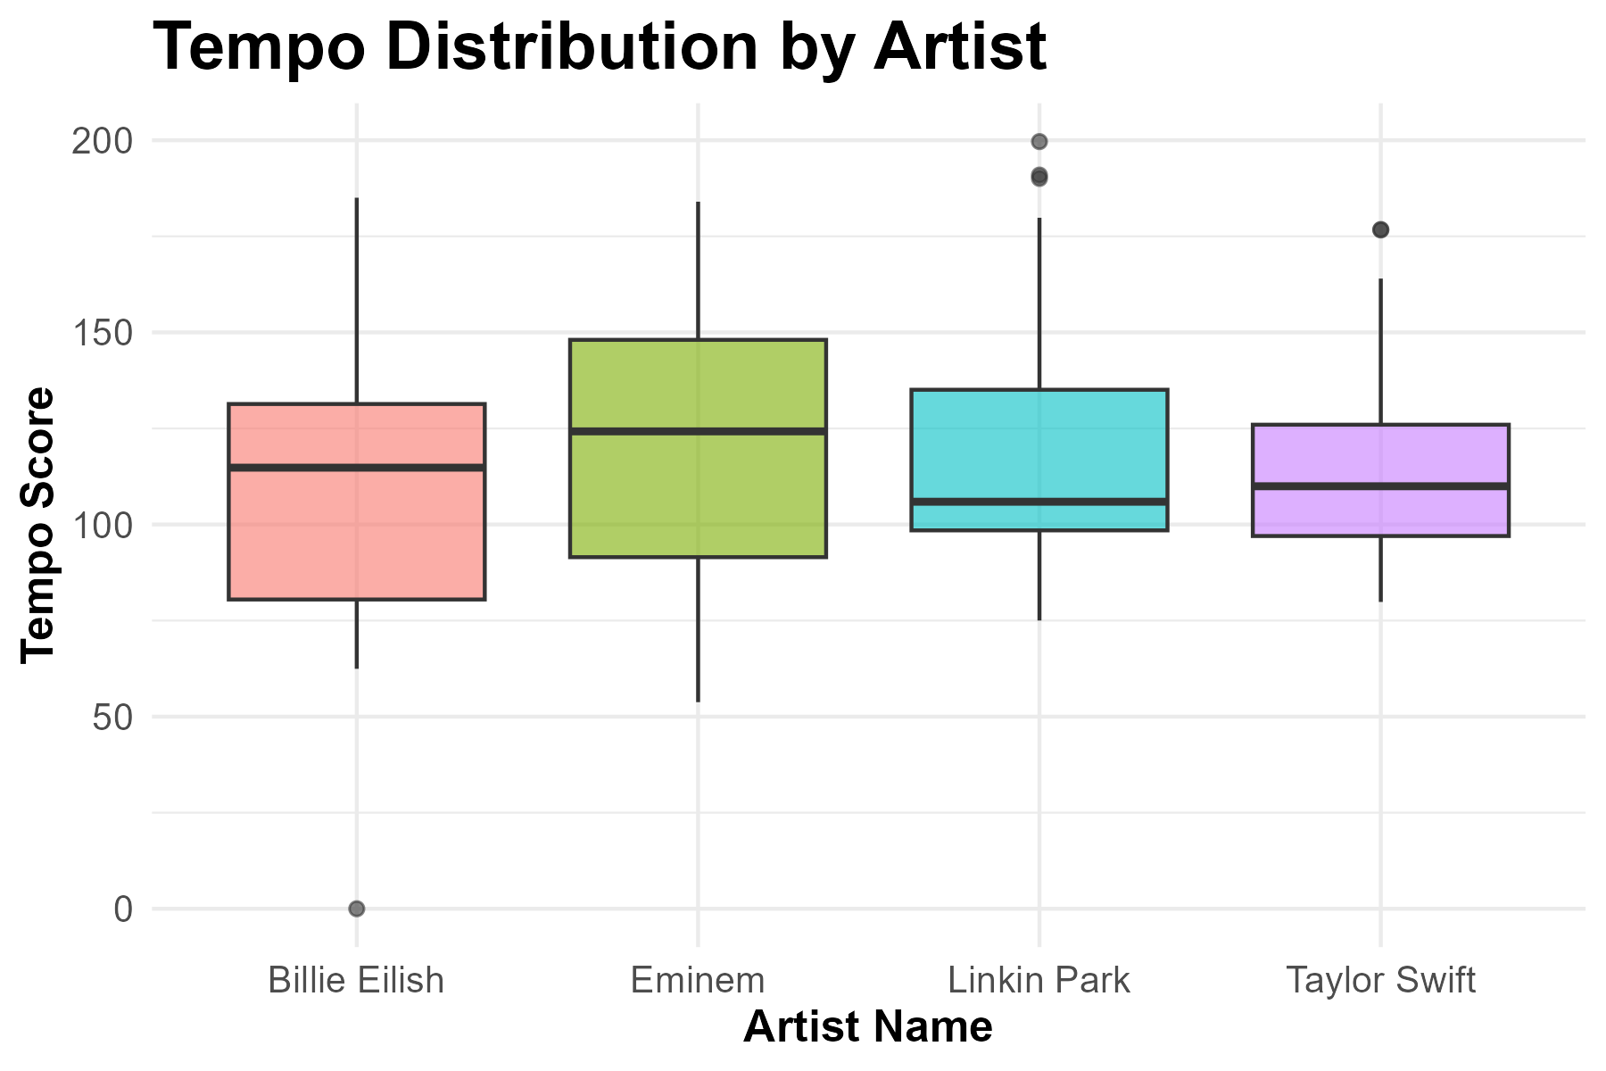
Upgrade
Team 13
Intro
About Data
artist_name | Billie Eilish | Eminem | Linkin Park | Taylor Swift
min_danceabilty | 0.000 | 0.429 | 0.215 | 0.336
max_danceabilty | 0.939 | 0.893 | 0.810 | 0.870
q1_danceabilty | 0.38050 | 0.65475 | 0.42275 | 0.63825
median_danceabilty | 0.6895 | 0.7480 | 0.4910 | 0.6595
q3_danceabilty | 0.82350 | 0.80925 | 0.55375 | 0.69600
Our Artists
Features
Word Cloud
Sentiment Analysis
Conclusion
artist_name | Billie Eilish | Eminem | Linkin Park | Taylor Swift
min_tempo | 0.000 | 53.767 | 75.004 | 79.846
max_tempo | 185.044 | 184.008 | 199.652 | 176.768
q1_tempo | 80.48350 | 91.50025 | 98.47300 | 97.00125
median_tempo | 114.7910 | 124.2385 | 105.9250 | 109.9530
q3_tempo | 131.3575 | 148.0553 | 135.0650 | 125.9720

Slide 6
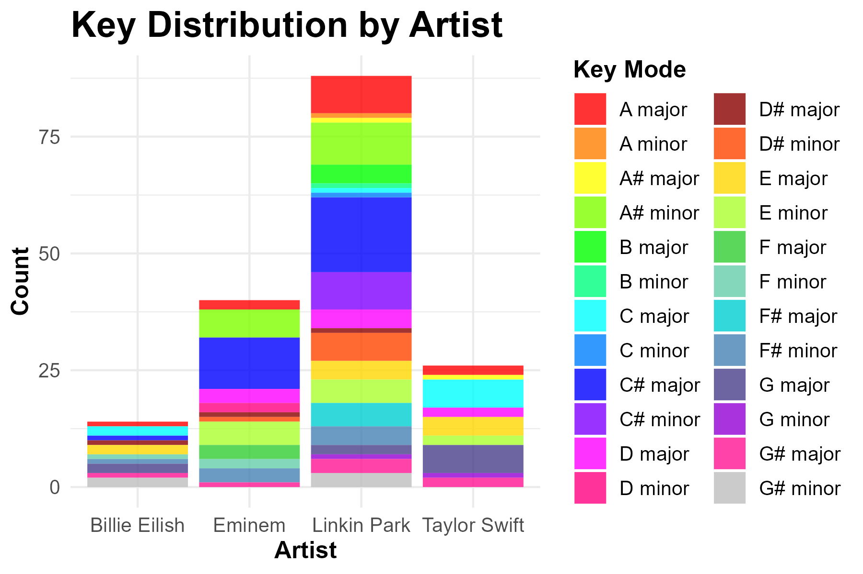
Upgrade
Team 13
Intro
Artist_names | 3 most used Key_mode | Count
Billie Eilish | C | 2
 | E | 2
 | G | 2
Eminem | C# | 11
 | A# | 6
 | E | 5
Linkin Park | C# | 16
 | A# | 9
 | A | 8
Taylor Swift | C | 6
 | G | 6
 | E | 4
About Data
Our Artists
Features
Word Cloud
Sentiment Analysis
Conclusion

Slide 7
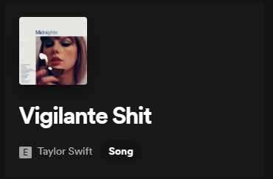
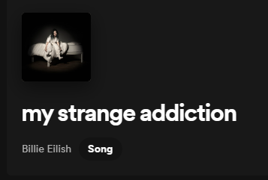
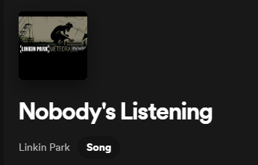
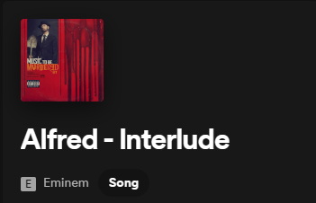
Upgrade
Team 13
Analysing the songs
Intro
About Data
Our Artists
Features
Word Cloud
Key
Sentiment Analysis
Danceability
Speechiness
Conclusion
Tempo
Valence

Slide 8
Upgrade
Team 13
Intro
Data Loading and PreProcessing
About Data
Our Artists
Features
We used Spotify APi to get the currently trending albums of the chosen artists and genius API to retrieve lyrics for the songs in each of those albums.
Removing punctuations and special characters: Punctuations and special characters such as parentheses, brackets, asterisks, etc., can interfere with natural language processing algorithms. Removing them helps to ensure the accuracy of the analysis.
Lowercasing all text: Converting all text to lowercase helps to ensure consistency and reduces the number of unique words in the dataset, which makes it easier to analyze.
Removing stop words: Repetitive words a, the, if, or, …etc do not carry any significant meaning and can be removed to reduce the dimensionality of the dataset.
Custom stop words: Song lyrics have a lot of vocal words like Oh, Ah, da da,yeah, uh huh,...etc. These can be removed too.
Word Cloud
Sentiment Analysis
Conclusion

Slide 9
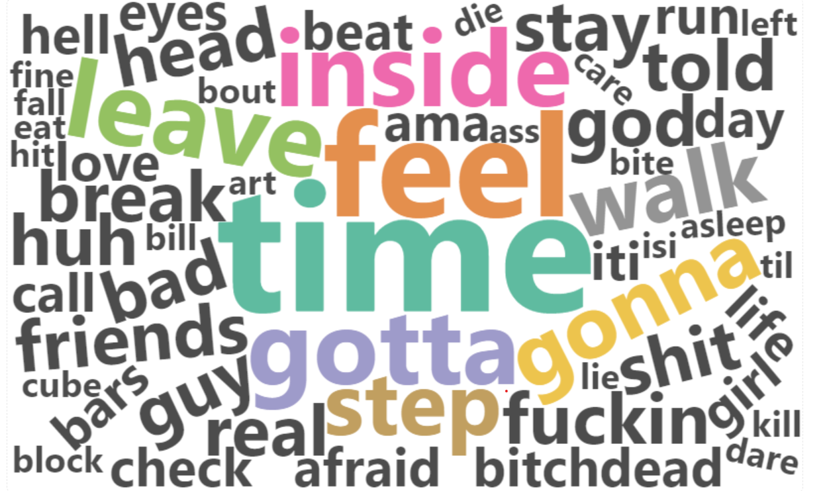
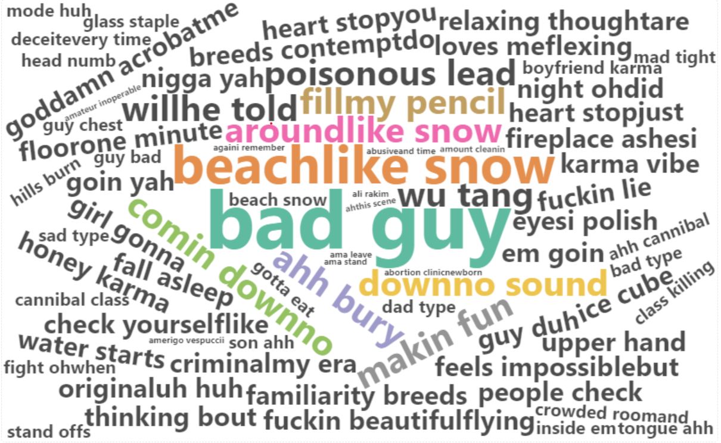
Upgrade
Team 13
Intro
Word frequency analysis
About Data
Our Artists
Features
Most frequent words
Word Cloud
Sentiment Analysis
Conclusion
Most frequent bigrams

Slide 10
Upgrade
Team 13
Intro
Sentiment Analysis
About Data
Our Artists
Features
The albums are scored for positivity and negativity using afinn lexicon.
The ratio of positive words to negative words gives us another metric that indicates how positive or negative the song is.
Word Cloud
Sentiment Analysis
Conclusion

Slide 11
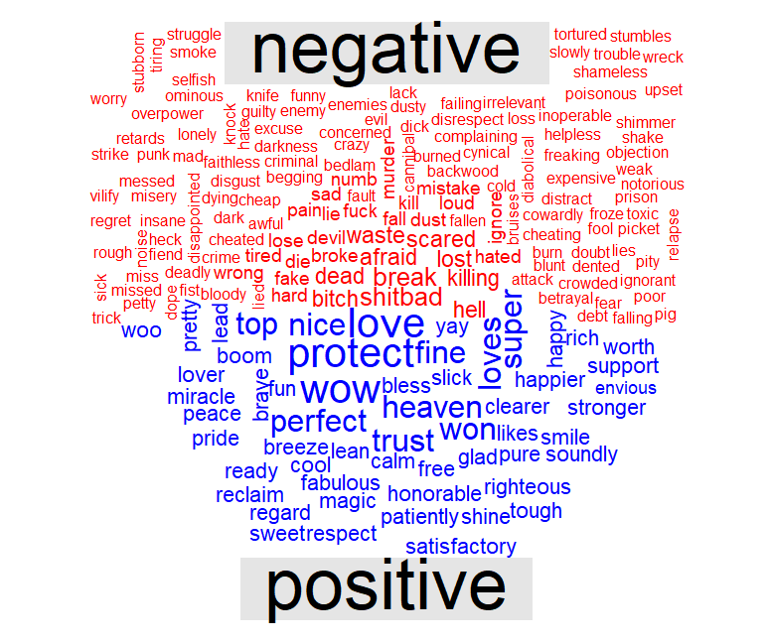
Upgrade
Team 13
Intro
Visualising negative &
positive words
Intro
About Data
About Data
Our Artists
Our Artists
Features
Features
Word Cloud
Our Services
Achievements
Sentiment Analysis
Our Goals
Conclusion
WordCloud
Pricing
Contact Us

Slide 12
Upgrade
Team 13
Intro
Sentiment Analysis Contd.
About Data
Our Artists
The words in each album have been analysed using nrc_lexicon that separates them into eight basic emotions (anger, disgust, fear , anticipation, trust, sadness, joy and surprise) and two sentiments (positive and negative) based on their association with the words in the lexicon.
The proportion of each emotion can further be plotted for each album which gives us an idea of what the dominating emotion is in each album.
Features
Word Cloud
Sentiment Analysis
Conclusion

Slide 13
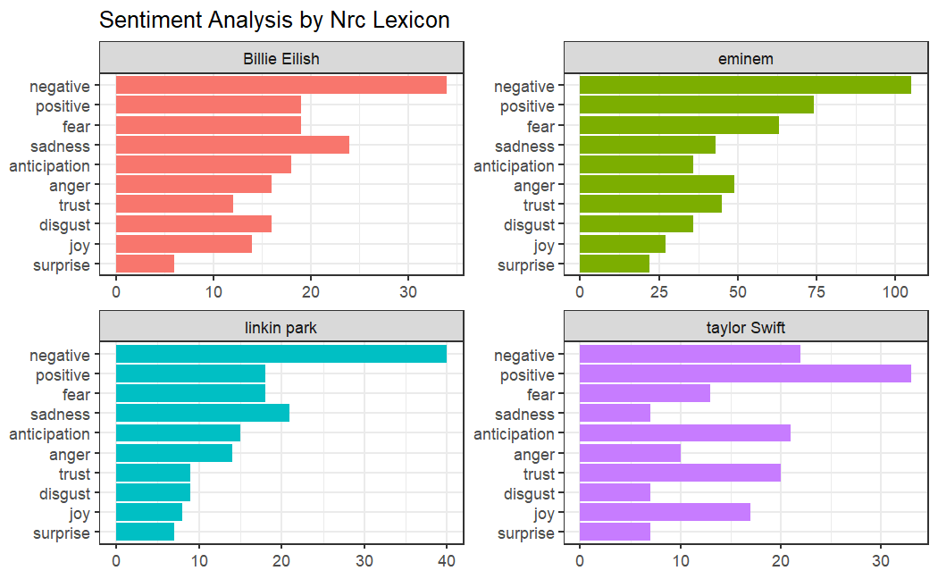
Upgrade
Team 13
Intro
Distribution of emotions
by each artist
Intro
About Data
About Data
Our Artists
Our Artists
Features
Features
Word Cloud
Our Services
Achievements
Sentiment Analysis
Our Goals
Conclusion
WordCloud
Pricing
Contact Us

Slide 14
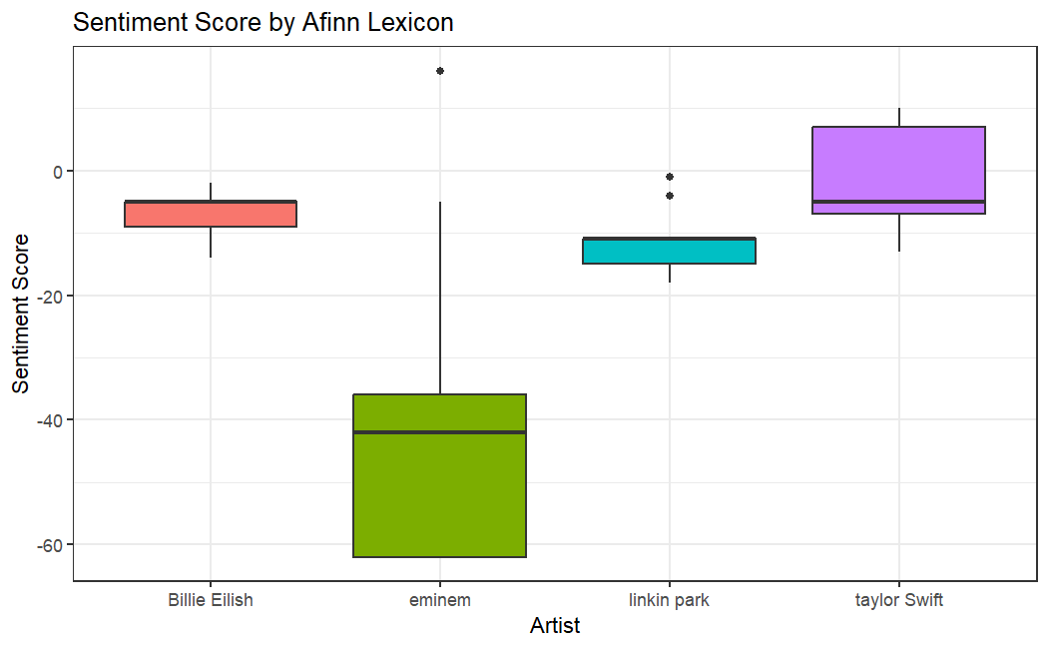
Upgrade
Team 13
Intro
Intro
Range of sentiment scores
for each artist
About Data
About Data
Our Artists
Our Artists
Features
Features
Word Cloud
Our Services
Achievements
Sentiment Analysis
Our Goals
Conclusion
WordCloud
Pricing
Contact Us

Slide 15
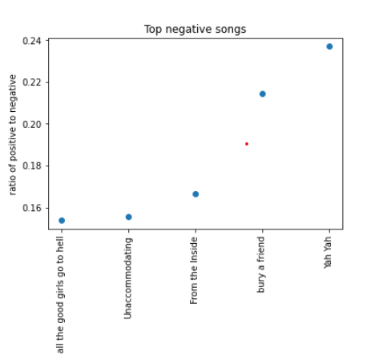
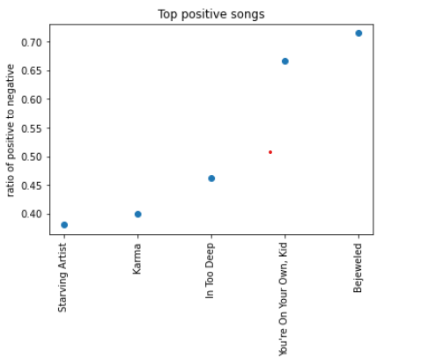
Upgrade
Team 13
Intro
Intro
Top positive and top negative songs
About Data
About Data
Our Artists
Our Artists
Features
Features
Word Cloud
Our Services
Achievements
Sentiment Analysis
Our Goals
Conclusion
WordCloud
Pricing
Contact Us

Slide 16
Upgrade
Team 13
Intro
Intro
About Data
About Data
Our Artists
Most negative song in our data: All the good girls go to hell by Billie Eilish 0.153
Most positive song in our data: Bejeweled by taylor swift 0.7142
Our Artists
Features
Features
Word Cloud
Our Services
Achievements
Sentiment Analysis
Our Goals
Conclusion
WordCloud
Pricing
Contact Us

Slide 17


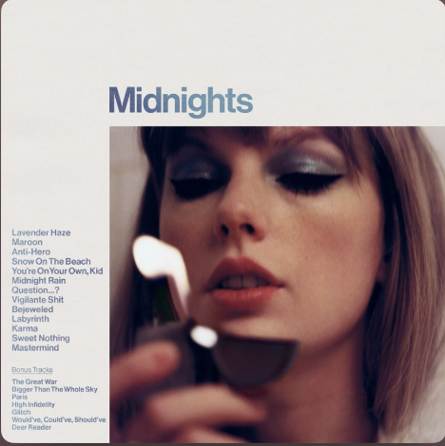

Thank You
Bejeweled
Taylor Swift
0:23
-3:25

